Slide 1
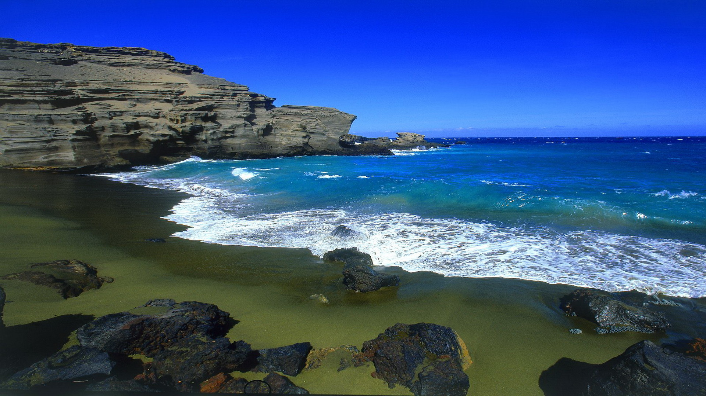
WATER POLLUTION
By:-Smt. Suniti Dash

Slide 2
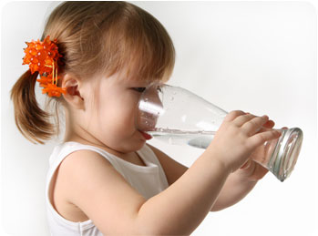
Water is life. Our body is made of 70% of water. Without water we can’t survive.
We use water for different purposes like:
Drinking
Bathing
Cooking
Agriculture
Industry
Navigation

Slide 3
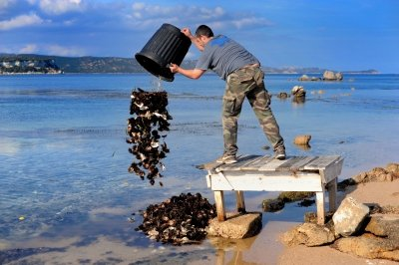
We need water for our survival but we make it polluted and it becomes unsuitable to drink and use .Rapid industrialisation, Urbanisation are the responsible causes of water pollution. People’s carelessness and ignorance is also one of the major cause.

Slide 4
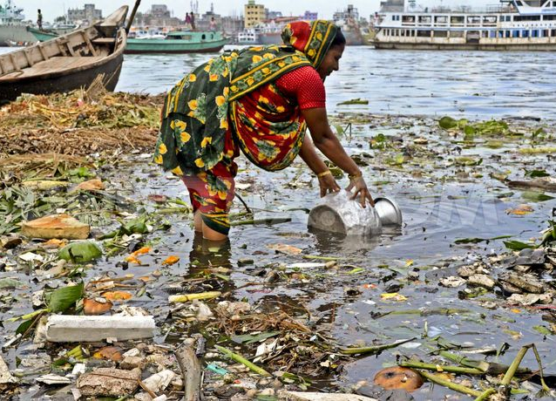
What is water pollution?
The contamination of water bodies by which there is alternation of physical, chemical, and biological properties of water which may cause harmful effect on human and aquatic life.
Types of water pollution:
1 -Surface water pollution
2 -Ground water pollution

Slide 5
Sources of water pollution
There are two major sources of water pollution
1-Natural source includes soil erosion, flood, landslides marine pollution, volcanic eruption, and decomposition of plants and animals.
2-Man made sources include Urbanisation, Industrialisation, agricultural source, cultural sources-marine pollution due to oil and petroleum etc

Slide 6
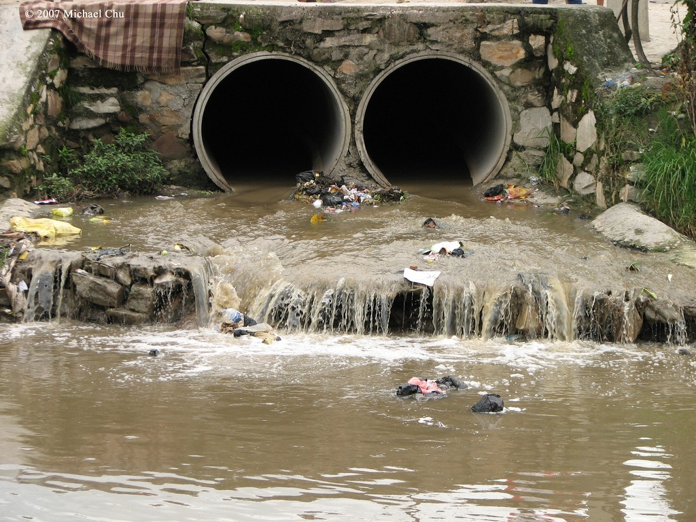
So some of the major man made sources of WATER POLLUTION are-
A-Sewage and other waste from cities
Sewage is otherwise known as water borne domestic waste and urban runoff discharged into water bodies like river, pond and sea.. It includes human excreta, paper, cloth, soap, detergent
urban runoff, animal waste etc.
They contain sodium, calcium,
Potassium & chloride ions,
carbonates and Pathogenic
microorganisms.

Slide 7
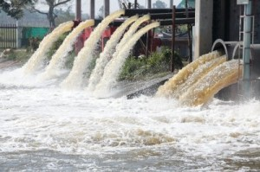
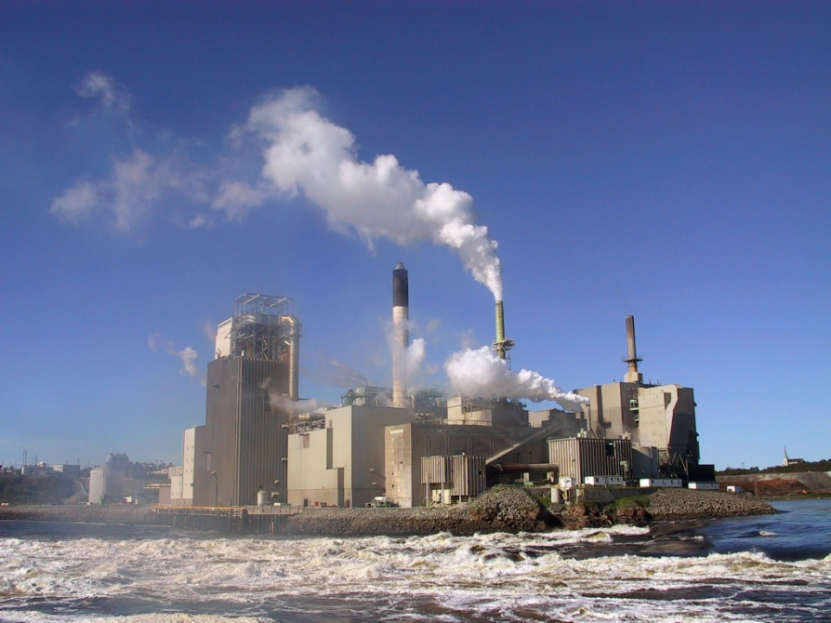
B-INDUSTRIAL WASTE OR EFFLUENTS
The effluents of breweries, factories, tanneries, dying textiles, paper and pulp mills contain major pollutants like oils,plastics,metallic wastes phenols,toxin,acids,salts . Industrial waste also have acids and alkalies,flourides,free ammonia, ammonic nitrogen. When these effluents fall into river or water bodies there is increase of toxic substances and deoxygenating of water.
Besides these Nitrate,Copper,Chromium,mercury,lead are the heavy metallic effluents discharged from industries and cause serious health hazards of living organisms. Lead is responsible for causing damage in liver and kidney.

Slide 8
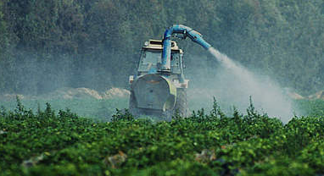
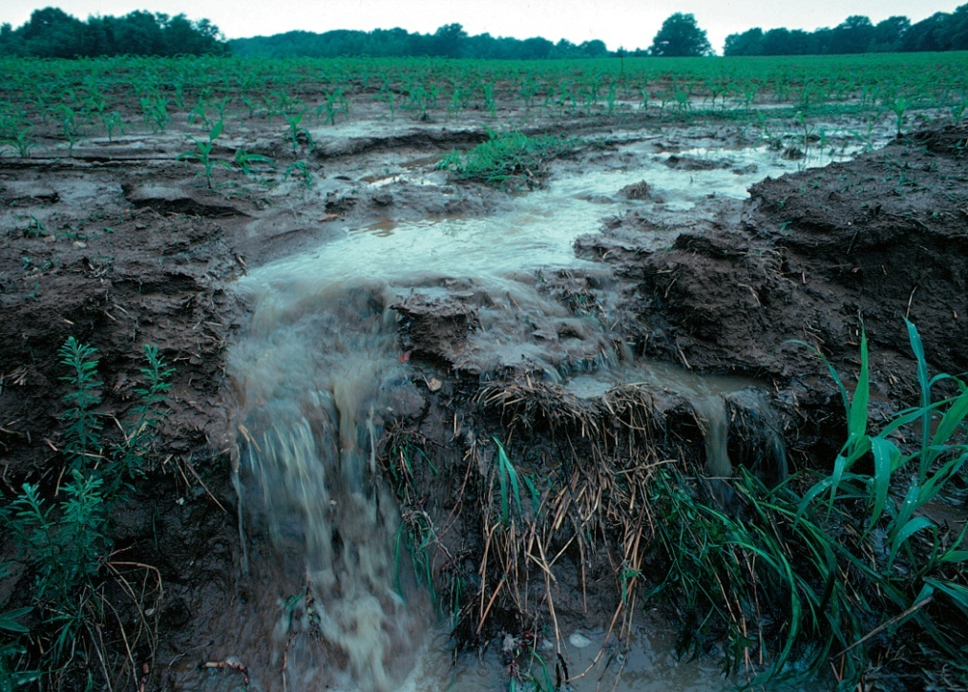
C-Agricultural waste-
The use of fertilizer, pesticides, herbicides also cause water pollution. The use of DDT, endrin heptachlor or toxophan etc in agricultural land during cultivation. These substances when come into contact with heavy rainfall and mix with water bodies they cause water pollution. They accumulate in the body of aquatic plants and animals causing slow poisoning.
They also accumulate in tissues of living beings in increasing concentration along with the food chain is called biological magnification.

Slide 9
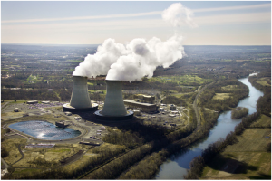
D-Thermal pollution-
Water is used for cooling in atomic energy plants and coal oil fired generators ,the resultant warm water is discharged into water bodies like river streams etc. It causes thermal pollution of water causing changes in aquatic life.

Slide 10
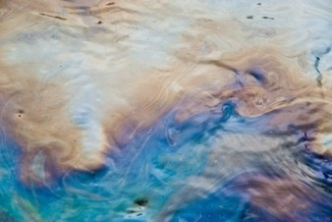
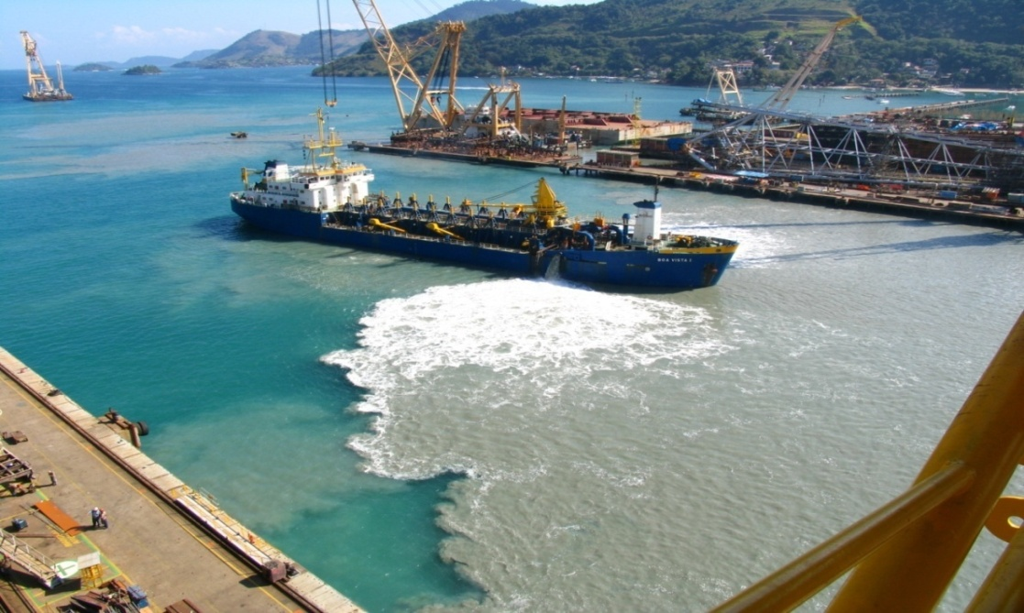
E-Petroleum oil:
The leakage of petroleum oil in to the sea during drilling and during shipping operations pollute the water. These produce toxic substance in water which kill fishes and other aquatic animals.

Slide 11
Effect of water pollution
Eutrofication- Sewage and urban runoff discharged into river and ponds carries phosphate through detergent which is responsible for creation of luxuriant growth of algae which form water blooms. This consumes most of the available oxygen from water. This is called Eutrophication.
Some decomposing plants produce toxins as strychnine which kills animals including cattle.
When sewage mix with river, pond or surface water they may cause- Typhoid, dysentery poliomilities and hepatitis like serious health hazards.
Pesticides create diseases like kidney failure, blood ,urine and damage of brain tissues.
Use of DDT and pesticide is responsible to create headache, heart disease, vomiting weakness etc. It also reduces hormone level of living organisms.

Slide 12
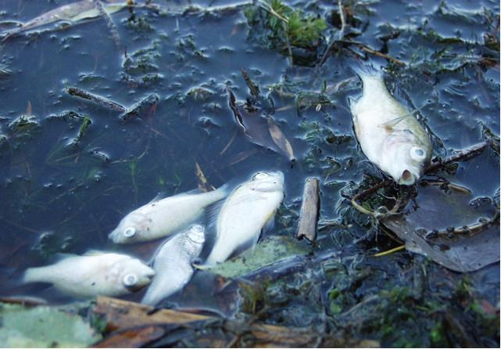
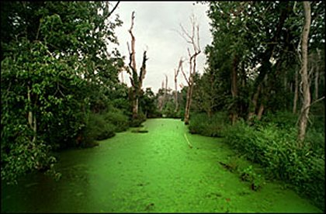
Eutrofication
Fishes died due to polluted water

Slide 13
Prevention and control of water pollution
Sewage treatment plant is also known as Waste water treatement plant(wwtp) .
Sewage should be properly treated in sewage treatement plant which includes steps like :
Firstly Separting large debris by Sedimentation in tanks
2ndly it is sent to the upflow anaerobic sludge blanket.
3rd step is chemical oxidation of waste water by strong oxidizing agents such as chlorine gas, chlorate salts ozone gas and UV radiation. After this waste water can be discharged into natural water.
Industrial effluents should be treated and cleaned before discharged into water bodies.
Animal excreta such as cow and buffalo dung may be used in gas plant for cooking. This may also be used as manure.
Waste papers, plastics, waste food materials and decayed fruits and vegetables should not be thrown into open drain.
If oil sticks is formed in water body (sea, lake), it should be skimmed off with the help of a suction device.

Slide 14
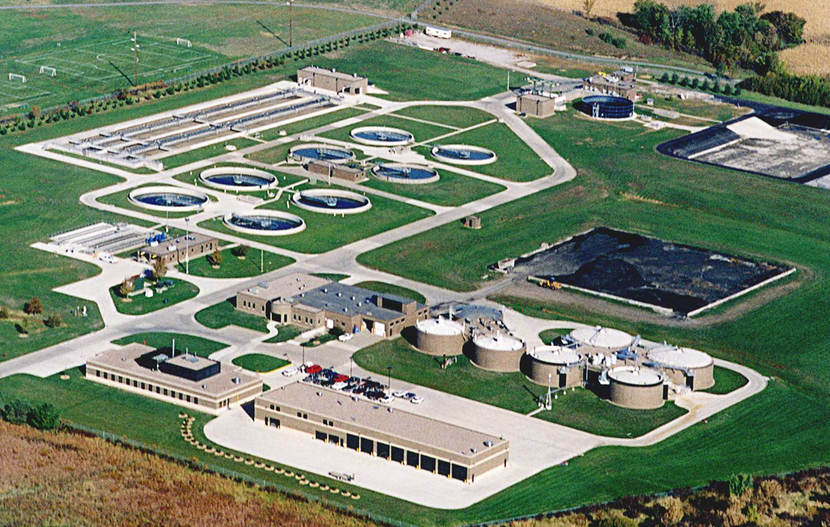
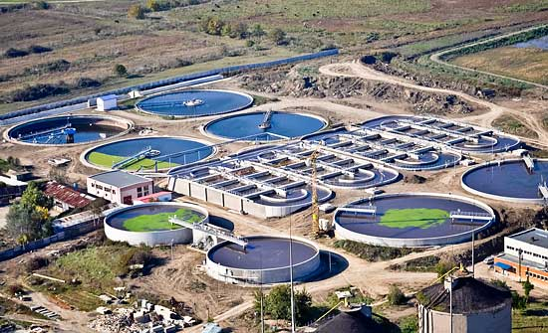

Slide 15
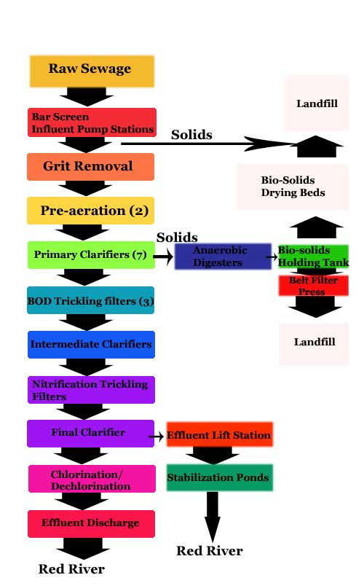
Purification of water.
Sedimentation,
Filtration,
Chlorination,
Decantation,
Boiling at 100⁰
Use of UV
Filters attached to the taps.

Slide 16
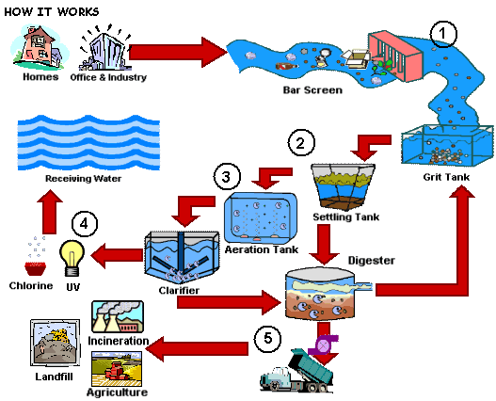

Slide 17
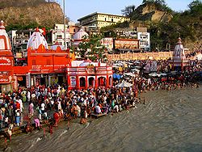
Water quality management
The central govt has formed water control act for quality management of water. Some of such examples are
-The Damodar vally corporation act 1948
The Water Act,1974
The Ganga project 1986

Slide 18
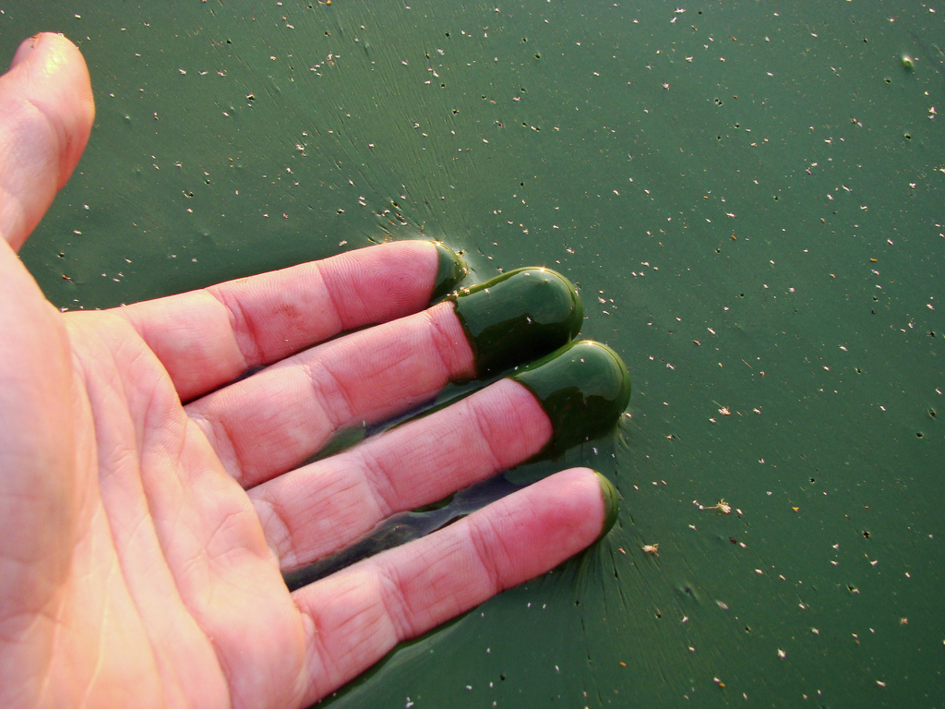
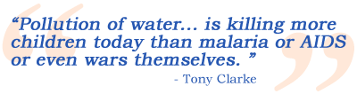

Slide 19
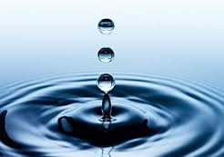
Let we should be trustee of our Environment
THANK YOU

